Slide 1
President’s Report 16 June 2016

Slide 2
IFC
Representatives 2016-2017
Tom Schuman (Pres FS)
Mark Fitch (Past pres)
Sahra Sedighsarvestani (Pres elect)
Actions for 2016-2017
Revisit Title IX activities on all campuses
Complete post tenure review CRR changes
Begin direct interactions with BOC

Slide 3
IFC Post Tenure Review
Bylaws (CRR) changes are proposed – early draft
To be distributed via FS website for comments campus wide
CRR changes are to clarify and unify CRR and actions
Annual reviews
Dovetail of annual reviews with post tenure review
Resources for improvements and pay incentive for performance
Dovetail of annual and post tenure reviews with workload policy
Post tenure review process
Bylaws changes approval
IFC after comment feedback
BOC after IFC

Slide 4
Campus
Campus committee vacancies
Grievance panel committee
Ed Malone submitted letter of resignation
RP&A accepted due to sabbatical, which would affect service
Other committees: to be filled at September meeting
Bylaws amendment
Rejected by UM System due to lack of diversity
Dean search committee composition
Lacked ‘Academic best practice’: outside consultants (IBIS)
In percentage of faculty only: as-specified 2/3; 1/2 Ok
Other aspects of bylaws amendments checked out

Slide 5
Campus

Slide 6
Campus
Collaborative on Academic Careers in Higher Education (COACHE)
Survey closed April 8, 2016
Per System: “Results due to campus in July”
Administrative review
Closed midnight, 28 March
Results (data) have been viewed
Motion: criteria for publishing of results to Faculty Senate: 51% participation (of 403 surveyed, ≥ 206)
Achieved for Chancellor (229) and Dean (87) positions
Committee report to follow in agenda

Slide 7
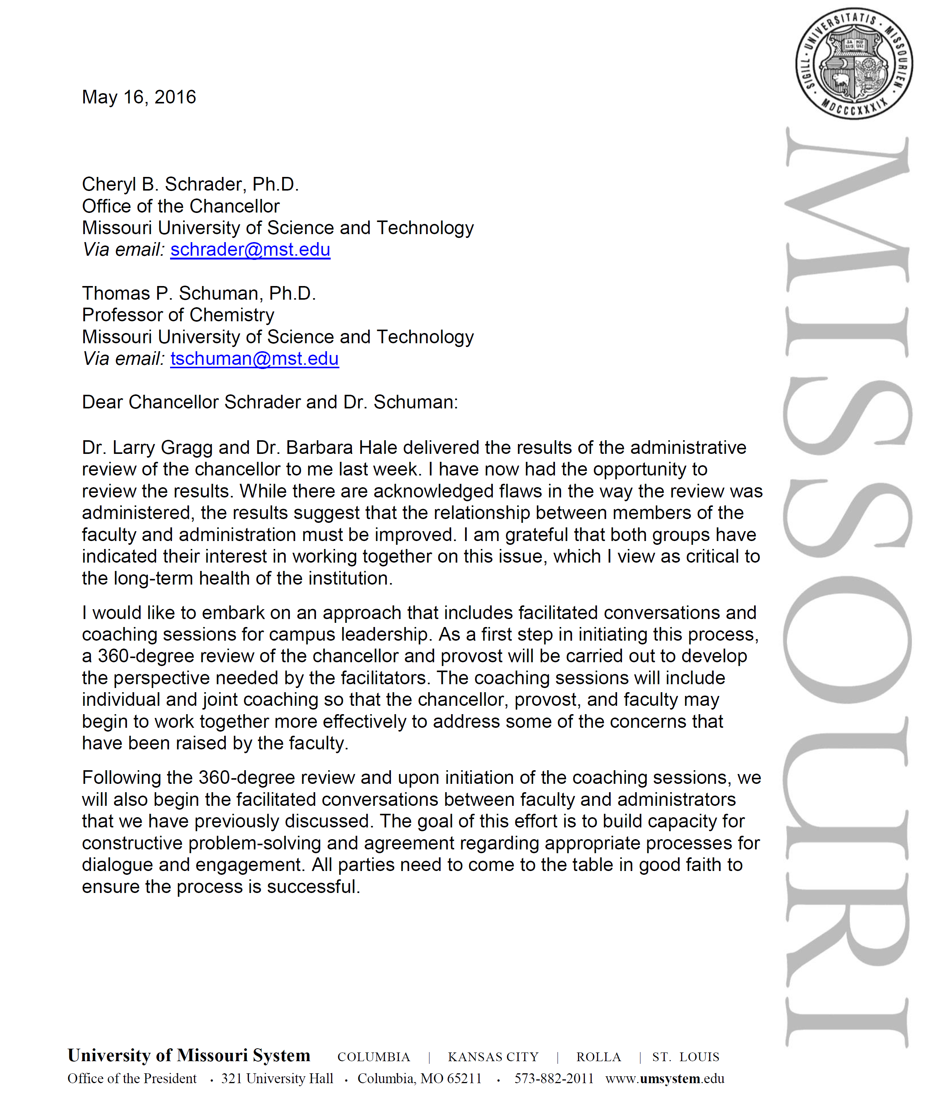
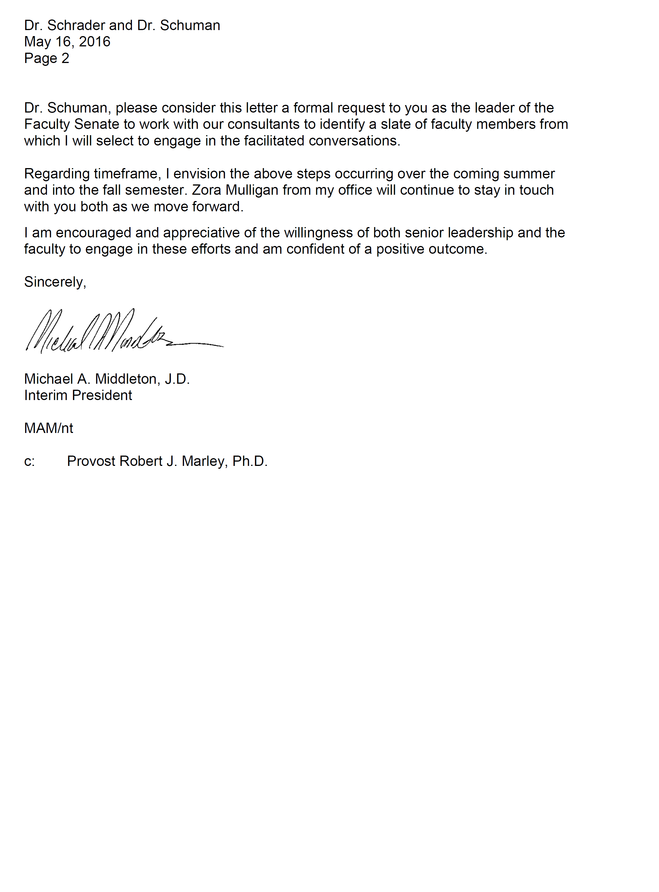
Campus

Slide 8
Campus
Graduate Student Funding Policy Committee
Presented report to Chancellor and Provost 11 April
Chancellor wanted time to review
Provost indicated implementation is needed asap
Committee continuing to interact with Chancellor, VC Branson and FS President toward implementation of policy
Budget meeting between FS officers and admin
Tues 7 June; Provost, VC Branson, and Chancellor
Campus is addicted to increased enrollments

Slide 9
Staff Council
Thank you to the faculty who really stepped up and supported staff council in the production of Staff Day
Not everything ran as smooth as it could have
Staff Day was a great success
Success was in no small part thanks to the support given by many, many faculty members

